Slide 1
Introduction to Decentralized Finance
Exchange rate and trade balance

Slide 2
Real exchange rate and net exports
The real exchange rate (or terms of trade) is the rate at which domestic goods and services are traded for goods and services produced abroad.
The real exchange rate impacts the quantities of goods and services that are exported and imported.
Changes in net exports affect the overall economic activity.

Slide 3
Real exchange rate and net exports
A weaker domestic currency
facilitate the country’s exports of goods and services;
discourage the country’s imports of goods and services.
What happens to the “value” of net exports (difference between the value of exports and the value of imports)?

Slide 4
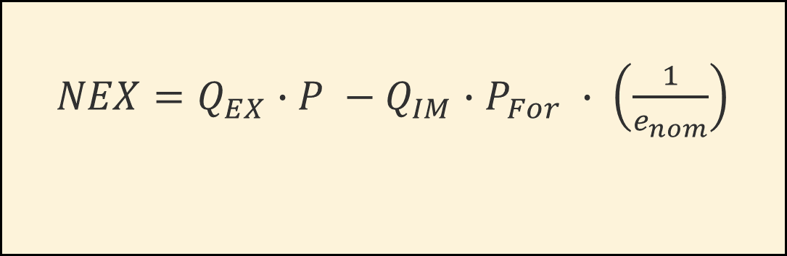
Net exports or trade balance
$NEX=Q_{EX}$ $∙P −Q_{IM}∙P_{For} ∙ \left(\frac{1}{e_{nom}}\right)$
Value of
exports
Value of
imports
e_{nom} is the nominal exchange rate: Units of foreign currency needed to buy one unit of domestic currency
A depreciation of the domestic currency decreases e_{nom}.
The depreciation increases the quantities exported and decreases the quantities imported.
If the quantities and prices do not change much in the short-run, then the “value” of net exports will decline.
With enough time, though, quantities will respond more and in the long run the “value” of next exports increases.

Slide 5
The J-curve: response of trade balance
In the short run it may be difficult to quickly change the quantities of goods imported and exported.
The country will then experience a trade larger deficit in the short run.
In the long-run, however, quantities of goods imported and exported adjust so that the trade balance improves.
Value of
net
exports
0
Time

Slide 6
Macroeconomic determinants of exchange rate and net export demand
Changes in output (income)
A rise in domestic income raises demand for goods and services, including imports, so net exports decline.
To purchase more imports, people must sell the domestic currency to buy foreign currency. This depreciates the domestic currency.
Changes in the real interest rate
A rise in the domestic real interest rate causes foreigners to buy our assets more, increasing the demand for our currency, which appreciates.
The rise in the value of the domestic currency leads to a decline in net exports

Slide 7
Summary
 | Effect on the value of the domestic currency | Effect on net exports
Increase in domestic output/income, Y | Fall | Fall
Increase in foreign output/income, Y_{For} | Rise | Rise
Increase in domestic real interest rate, r | Rise | Fall
Increase in foreign real interest rate, r_{For} | Fall | Rise

Slide 8
Summary
 | Effect on the value of the domestic currency | Effect on net exports
Increase in domestic output/income, Y | Fall | Fall
Increase in foreign output/income, Y_{For} | Rise | Rise
Increase in domestic real interest rate, r | Rise | Fall
Increase in foreign real interest rate, r_{For} | Fall | Rise

Slide 9
Summary
 | Effect on the value of the domestic currency | Effect on net exports
Increase in domestic output/income, Y | Fall | Fall
Increase in foreign output/income, Y_{For} | Rise | Rise
Increase in domestic real interest rate, r | Rise | Fall
Increase in foreign real interest rate, r_{For} | Fall | Rise

Slide 10
Summary
 | Effect on the value of the domestic currency | Effect on net exports
Increase in domestic output/income, Y | Fall | Fall
Increase in foreign output/income, Y_{For} | Rise | Rise
Increase in domestic real interest rate, r | Rise | Fall
Increase in foreign real interest rate, r_{For} | Fall | Rise

Slide 11
Summary
 | Effect on the value of the domestic currency | Effect on net exports
Increase in domestic output/income, Y | Fall | Fall
Increase in foreign output/income, Y_{For} | Rise | Rise
Increase in domestic real interest rate, r | Rise | Fall
Increase in foreign real interest rate, r_{For} | Fall | Rise

Slide 12
The role of money supply
Purchasing Power Theory: (e_{nom} x P/ P_{For} )= 1
In growth rates:
% change e_{nom} = % change P_{For} - % change P
What determine the change in prices (inflation)?
We need to go back to the Monetary Theory

Slide 13

The quantity theory of money
$$M=\left(\frac{1}{V}\right)∙P∙Y$$
M = Money in circulation
V = Velocity of money
P = Nominal price
Y = Production

Slide 14
Monetary policy tools
Open market operations
Purchases of security in the secondary market increase money in circulation.
Discount window borrowing facility
The interest rate charged to banks when they borrow from the central bank: the “discount rate”.
Reserve requirements
The fraction of deposits that banks can use to make loans.
Interest paid on bank reserves
The interest rate paid on bank reserves affects the money multiplier.
Foreign currency operations
Purchases of currencies increase the foreign reserves of the country and increase the money supply.
Sales of foreign currencies decrease the foreign reserves of the country and decrease the money supply.

Slide 15
Monetary base = Currency of nonbank public + Bank reserves

Slide 16
Rational for policies toward the exchange rate
To reduce exchange rate fluctuations driven by speculation.
To prevent an appreciation of the domestic currency to favor exports.
To prevent a depreciation of the domestic currency to keep the price of imports low.

Slide 17
Policy regimes for the exchange rate
Floating or flexible exchange rates
Policy authorities do not intervene systematically in the market to affect the exchange rate. It could be a “clean float” or a “managed float”.
Fixed exchange rates
Policy authorities stand ready to purchase or sell foreign currency in order to balance the demand and supply at the targeted (fixed) exchange rate. It could be an “extreme peg” or “within a band”.

Slide 18
How to intervene in the foreign exchange
Buying and selling foreign currency.
Exchange controls restricting private demand and supply of currency.
Changing the domestic interest rate to affect short-term capital flows.
Macroeconomic policies that solve fundamental problems undermining exchange rate stability.

Slide 19
Defending a fixed exchange rate from depreciation
(extreme peg Peso/Dollar)
Peso
per $
S$
S$ after intervention
25
D$
20
23
Billions of $
Banco of Mexico
must sell
3 Billions $

Slide 20
Defending a fixed exchange rate from depreciation
(peg Peso/Dollar within a band)
Peso
per $
S$
S$ after intervention
26
25
24
D$
20
22
24
Billions of $
Banco of Mexico
must sell
2 Billions $

Slide 21
Where does the monetary authority get the foreign currency to intervene?
The monetary authority owns assets in foreign currencies (foreign reserves).
If countries are short of foreign reserves, they can borrow from other countries or international institutions.

Slide 22
Who owns
foreign
reserves?

Slide 23
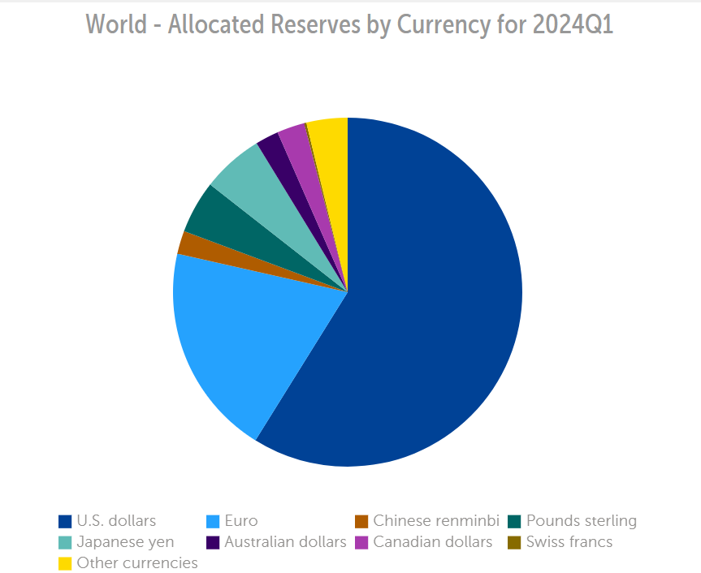
In what
currencies?

Slide 24
Defending a fixed exchange rate from appreciation
(extreme peg Peso/Dollar)
Peso
per $
S$
25
D$
17
20
Billions of $
Banco of Mexico
must purchase
3 Billions $

Slide 25
Defending a fixed exchange rate from appreciation
(peg Peso/Dollar within a band)
Peso
per $
S$
26
25
24
D$
D$ after intervention
16
18
20
Billions of $
Banco of Mexico
must purchase
2 Billions $

Slide 26
What does the monetary authority do with the purchased currency?
Increases the stock of foreign reserves.
Repays foreign debt.

Slide 27
How to intervene in the foreign exchange
Buying and selling foreign currency.
Exchange controls restricting private demand and supply of currency.
Changing the domestic interest rate to affect short-term capital flows.
Macroeconomic policies that solve fundamental problems undermining exchange rate stability.

Slide 28
Temporary disequilibrium
Peso
per $
Demand after
6 months
Demand after
12 months
S$
25
D$
17
20
23
Billions of $

Slide 29
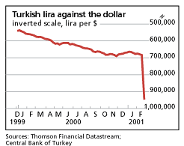
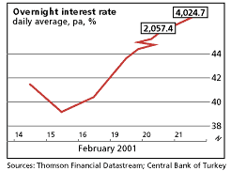
Currency crisis: Turkey in 2001

Slide 30
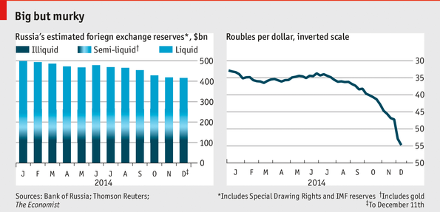
Currency crisis: Russia in 2014

Slide 31
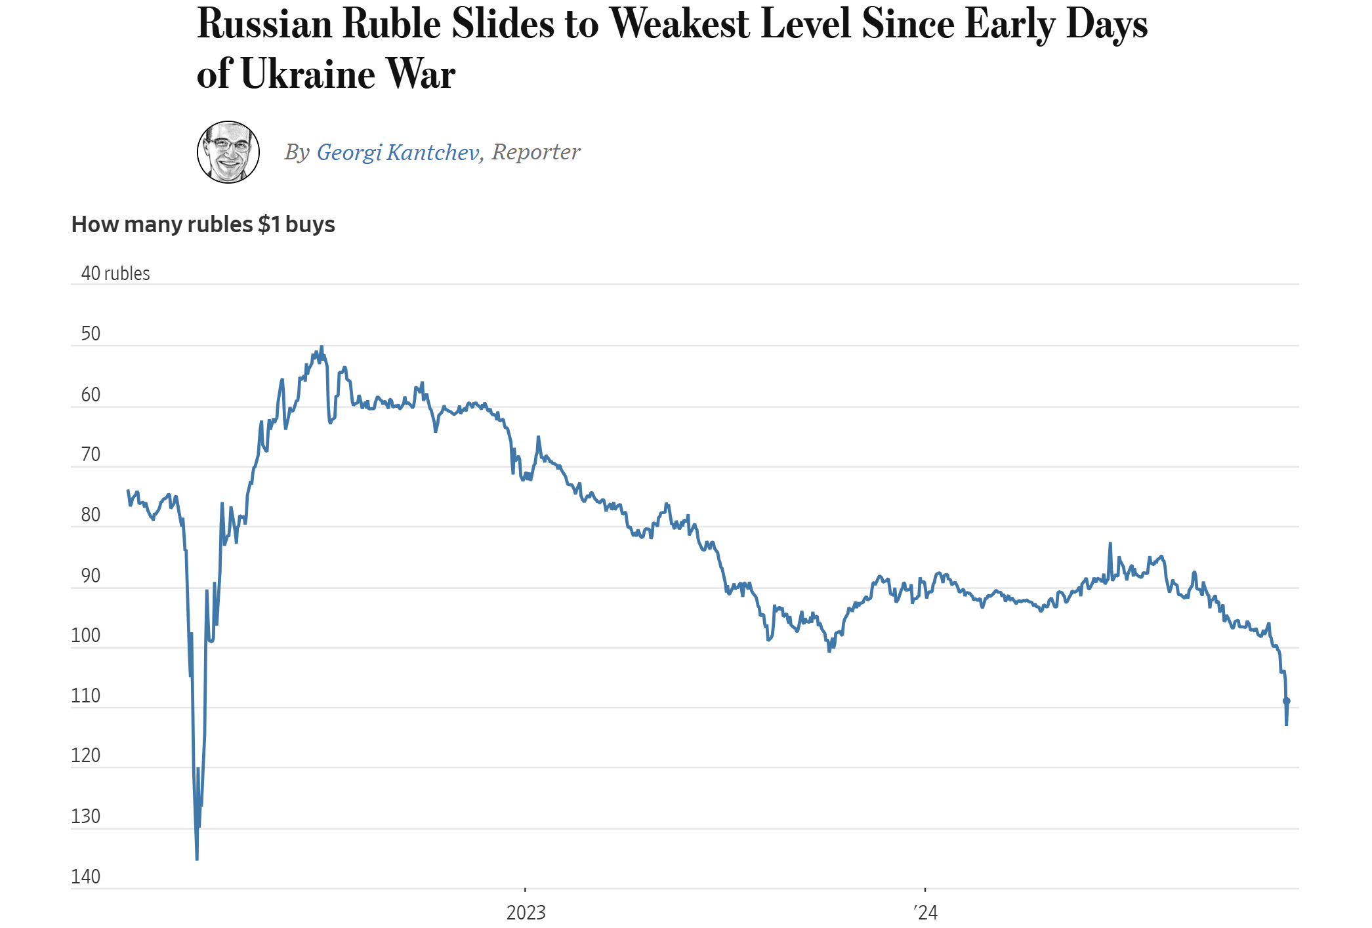

Slide 32
Direct exchange controls
All foreign exchange proceeds must be turned over to the monetary authority.
Anyone needing foreign currency must request it from the monetary authority.
Sometimes only some operations are subject to exchange controls.

Slide 33
Example of exchange control
Yuan
per $
S$ w/o exchange controls
China allows each Chinese resident to buy no more than $50,000 in overseas assets annually.
9
6.6
D$ w/o exchange controls
D$ with exchange controls
8
10
Billions of $
People Bank of China limits demand of dollars to 8 billions

Slide 34
Arguments for and against fixed exchange rate
Microeconomic considerations (Favorable to fixed rates)
Macroeconomic considerations (Against fixed rates)
Monetary Discipline (Favorable to fixed rates)

Slide 35
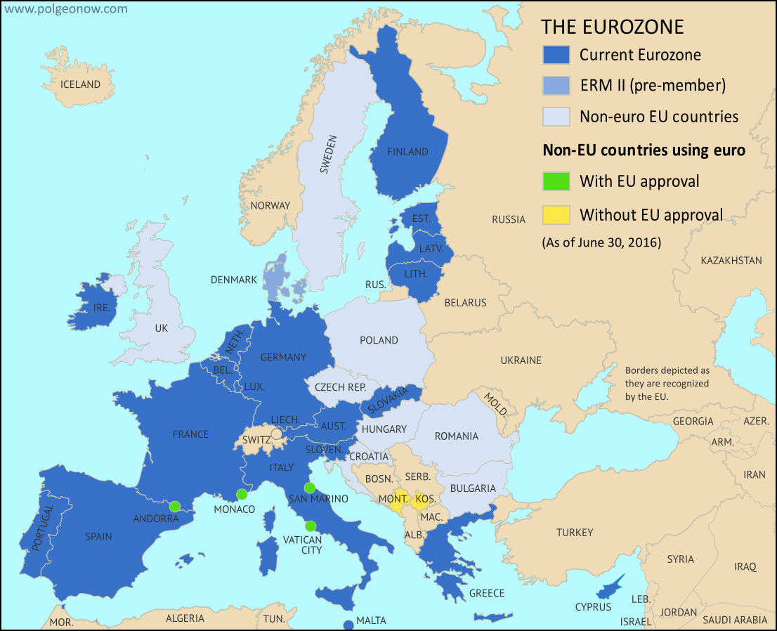
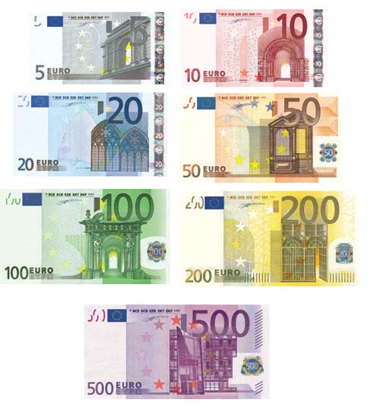
1. Microeconomic considerations
Fixed rates eliminate the exchange rate risk, encouraging cross-country business.
In the case of a single currency (ex. European countries), transaction costs are eliminated because there is no need to exchange currencies.

Slide 36
2. Macroeconomic considerations
With fixed rates the country cannot change the exchange rate to stabilize the economy.
Production = Aggregate demand
Aggregate demand = C + I + G + NX
C = consumption expenditures
I = Investment expenditures
G = Government purchases
NX = Net exports (Exports minus Imports)

Slide 37
3. Monetary discipline
Higher growth rates of money lead to higher inflation rates.
But higher inflation leads to a depreciation of the domestic currency.
The commitment to a fixed exchange rate requires the commitment to limit the quantity of money that the country can create (monetary discipline).

Slide 38
Inflation rate

Slide 39
Peso depreciation
Inflation rate
Currency board
1991-2001

Slide 40
Peso depreciation
Inflation rate
Currency board
1991-2001

Slide 41
Major forces causing a currency crisis
Waves of over-borrowing
Exogenous negative international shocks
Excessive exposure to exchange rate risks
Volatile international short-term lending
Global contagion

Slide 42
How to resolve a currency crisis
Rescue package by the IMF, World Bank or Governments.
Debt restructuring (rescheduling and reduction).

Slide 43
IMF members with largest voting rights, October 2025
Rank | IMF Member | Quota: percentage | Percentage votes
1 | United States | 17.43 | 16.50
2 | Japan | 6.47 | 6.14
3 | China | 6.40 | 6.08
4 | Germany | 5.59 | 5.31
5 | United Kingdom | 4.23 | 4.03
6 | France | 4.23 | 4.03
7 | Italy | 3.16 | 3.02
8 | India | 2.75 | 2.63
9 | Russia | 2.71 | 2.59
10 | Brazil | 2.32 | 2.22

Slide 44
How to prevent a currency crisis
Macroeconomic policies that do not lead to over-borrowing.
Avoiding short-term borrowing denominated in foreign currency.
Improve the regulation and supervision of the banking sector.
Other proposals are more controversial:
Countries should not try to keep a fixed exchange rate.
Countries should impose capital controls.
The IMF should not intervene.

